Slide 1
Topic: Classification of respiratory diseases using machine learning
1. Name: Mir Sadia Afrin
ID: 1712366642
2. Name: Jushraf Rahman
ID: 1812901042
Course: CSE499A
Section: 12
Date: 02.09.2021
Summer 2021

Slide 2
Problem analysis:
Our goal is to create a model to classify respiratory diseases with better accuracy by using machine learning.
It was difficult due to the lack of resources and dataset on this particular field
We used the Respiratory Sound Dataset from the ICBHI 2017 database.

Slide 3
Related works:
Lung Disease Classification using Deep Convolutional Neural Network
Asthma and Chronic Obstructive Pulmonary Disease (COPD) – Differences and Similarities
LungBRN: A Smart Digital Stethoscope for Detecting Respiratory Disease Using bi-ResNet Deep Learning Algorithm
Α Respiratory Sound Database for the Development of Automated Classification
XRAY AI: Lung Disease Prediction Using Machine Learning
Improving Disease Prediction by Machine Learning
So far LungBRN had the best accuracy which is 50.16% and we hope to improve it.

Slide 4
Over the course:
We reviewed a lot of ML research papers related to respiratory diseases.
We learnt basic structure of writing research papers.
We learnt basics of Convolutional Neural Network (CNN)
We dived deep into ML basics and Python programming
Work Division:
We divided the workload between our group mates where each of us reviewed a lot of papers. Mir Sadia was mostly in charge of the documentation part and Jushraf Rahman was mostly in charge of the coding.

Slide 5
What part of the project is most unique/original:
Areas where there is lack of skilled medical staff , a sound classification using our model can provide immediate diagnostic reports.
Help the medically under-served population
Our model aims to improve the existing architecture by providing better accuracy

Slide 6
Tools:
TensorFlow, Librosa, Keras, scikit-learn, Numpy, Pandas
Google Colab
Jupyter Notebook
Kaggle
Google Scholar
Youtube Sources

Slide 7
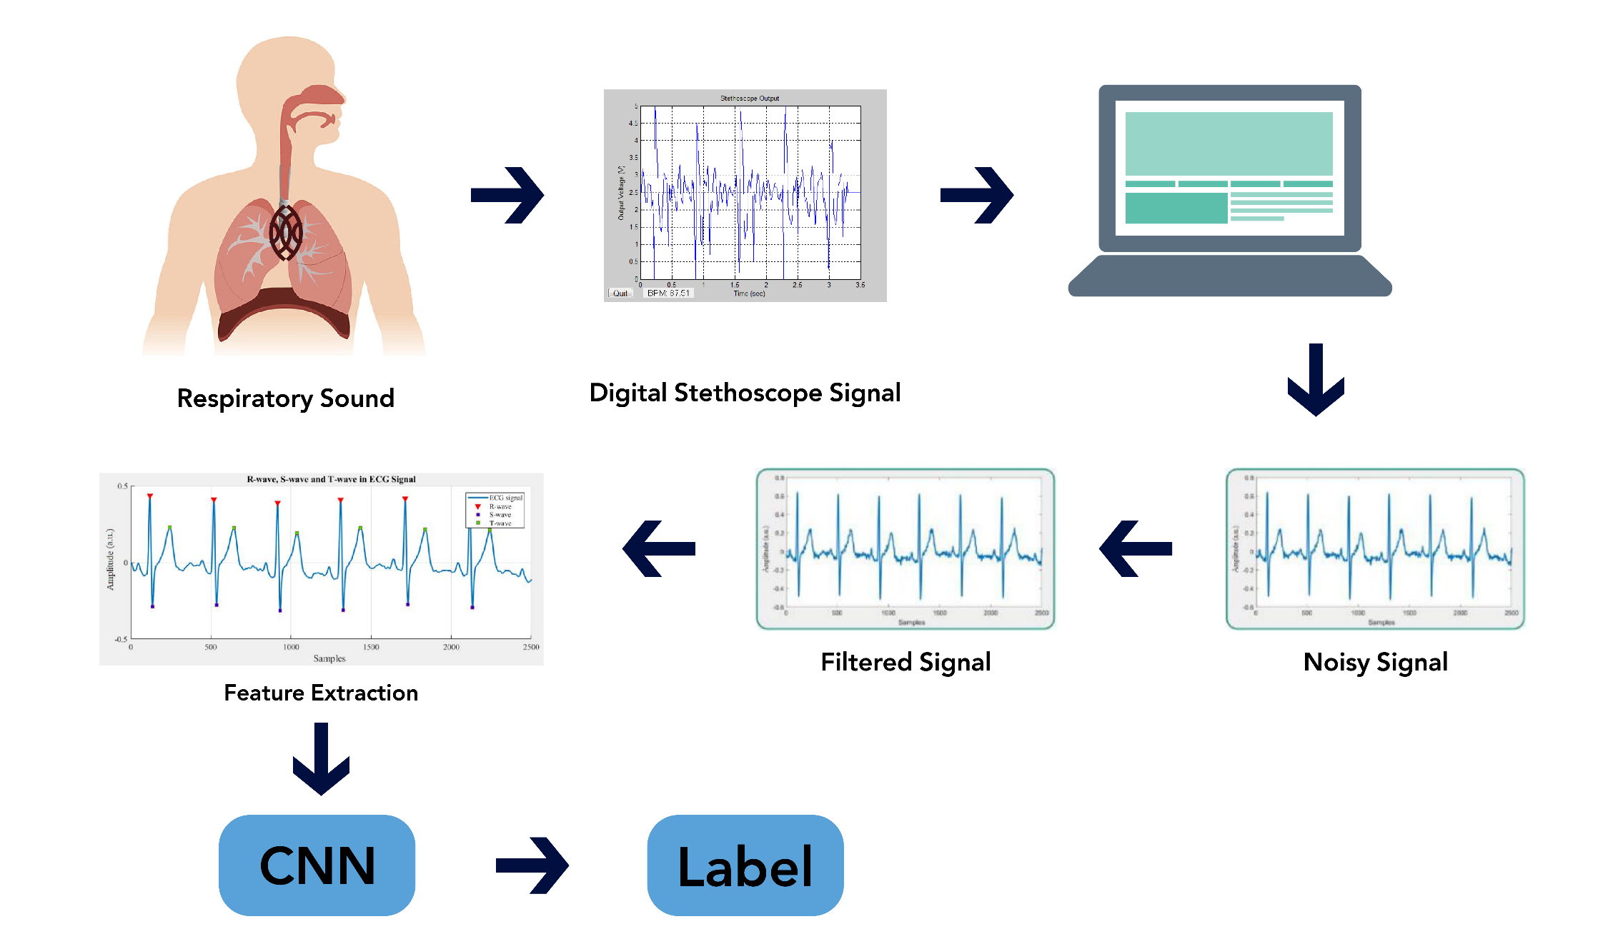
Design of the project:

Slide 8
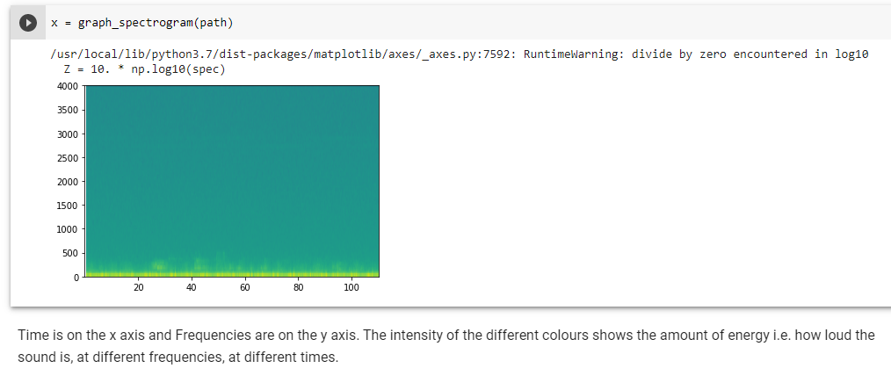
Results analysis
Fig: Conversion of breathing sound to digital spectogram

Slide 9
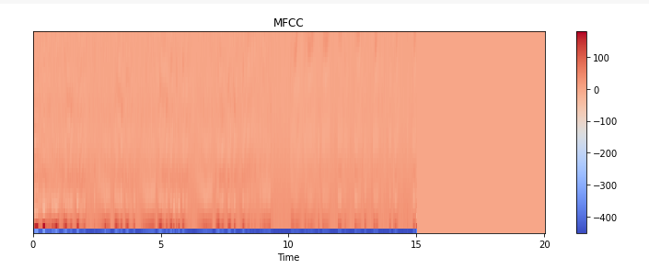
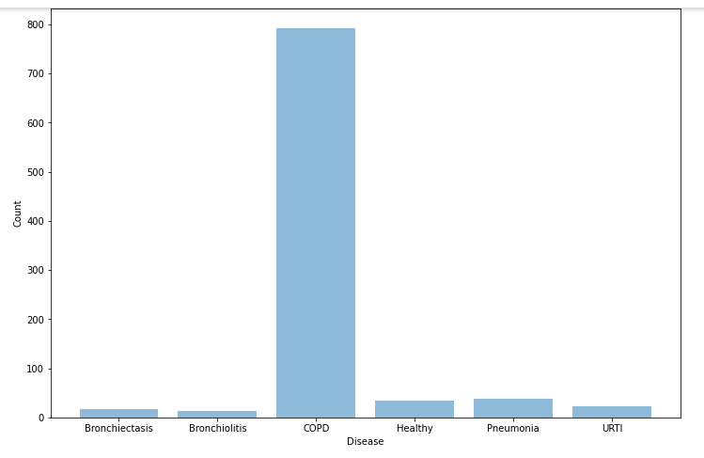
Fig: Conversion of audio file to MFCC

